Slide 1
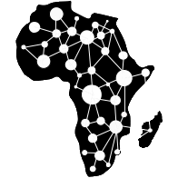

Environmental Data Acquisition and Processing
1
Water Resource Monitoring and Catchment Analysis
By
Jason Kabi
Centre for Data and Artificial Intelligence
DSAIL

Slide 2
Session breakdown
2
Session Brake Down
Motivation – The main goal
Water level (stage) monitoring – modelling concept
How is the water parameter being monitored?
Hardware development
Data acquisition
Data analysis – Anomaly detection
Data analysis – Prediction

Slide 3
Diagnosing or studying the catchment
Why?
Climate change
Encroachment by humans
Providing data for improved conservation efforts
Datasets that can acquired
River water parameters (stage, turbidity, pH etc.)
Satellite images that can acquired over time (vegetation cover)
Acoustic data (sound)
camera trap data (images)
Soil samples

Slide 4
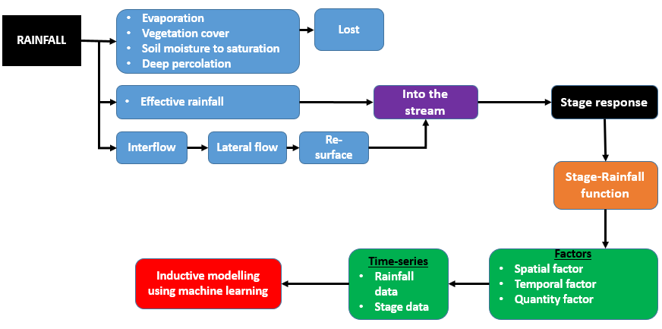
Motivation – modelling concept
4

Slide 5
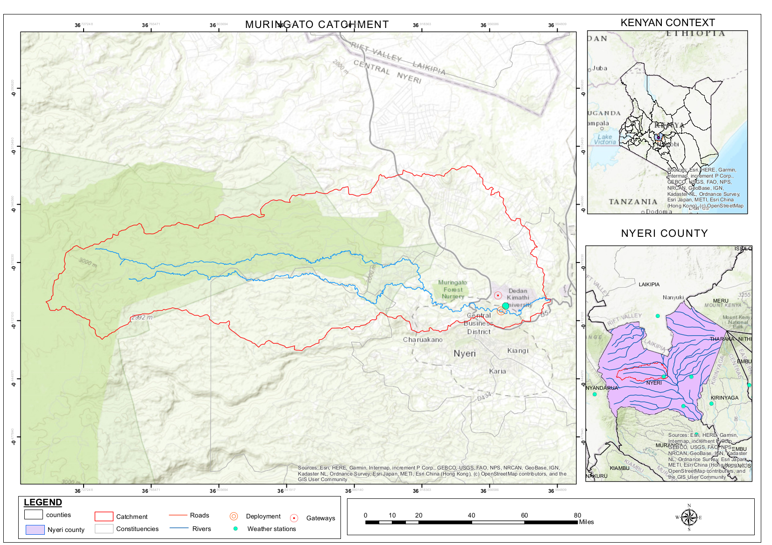
Catchment under study
5

Slide 6
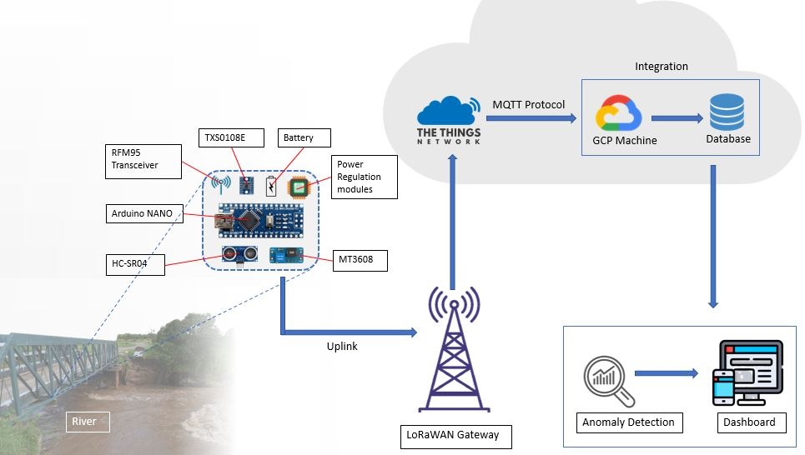
Water level monitoring Architecture (Flow Chart)
6

Slide 7
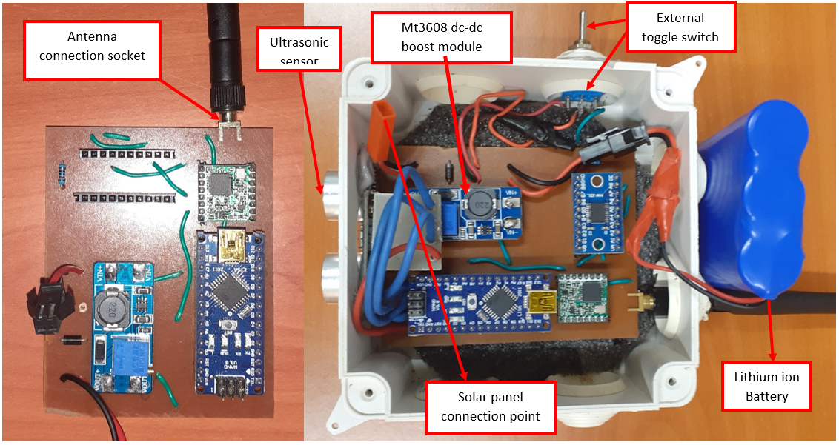
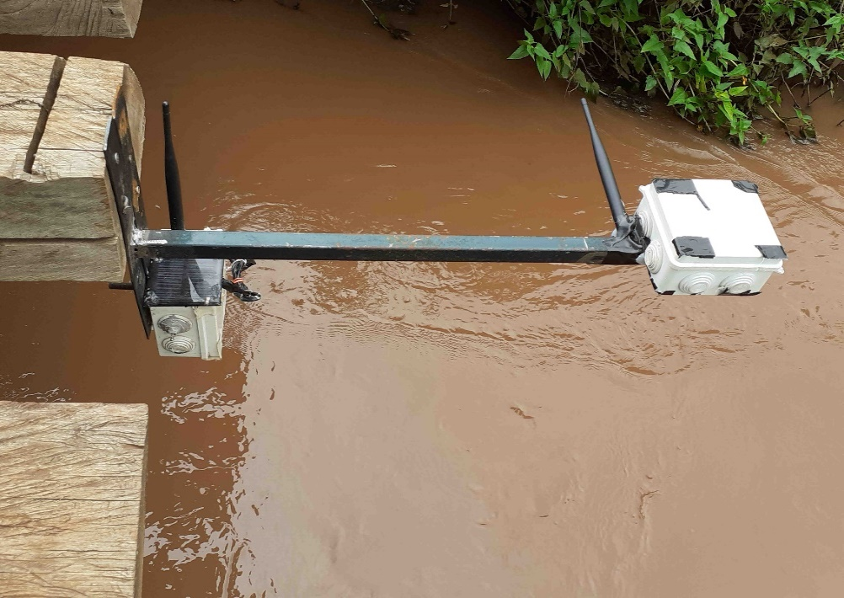
Hardware setup
7
Ready for deployment
Deployed

Slide 8
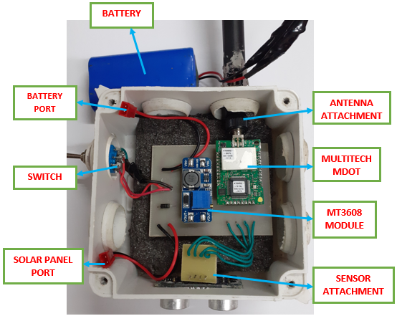
Prototype developed – MultiTech mDot based
$85

Slide 9
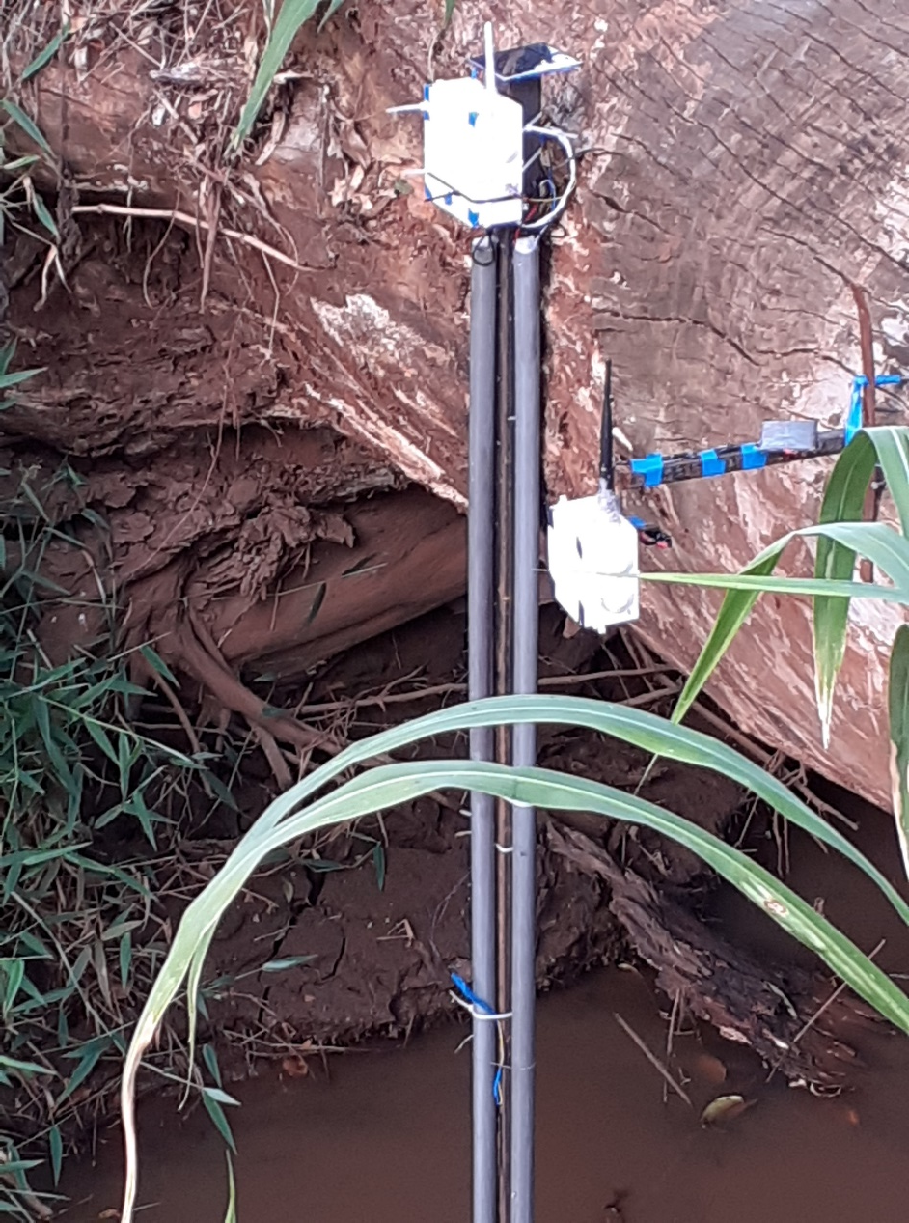
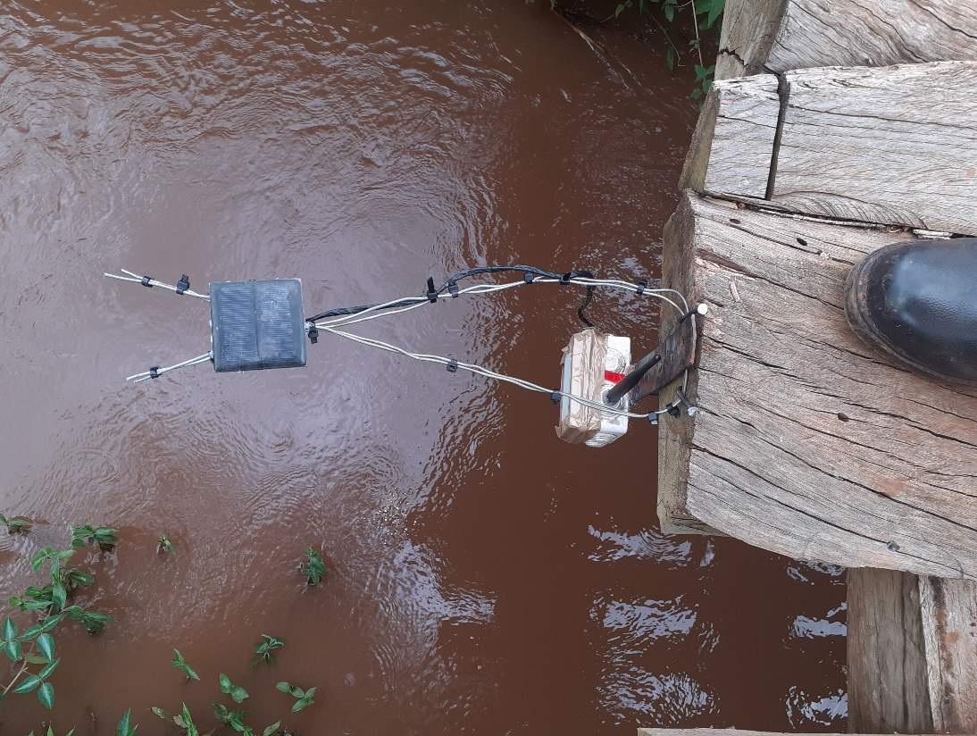
Deployment

Slide 10
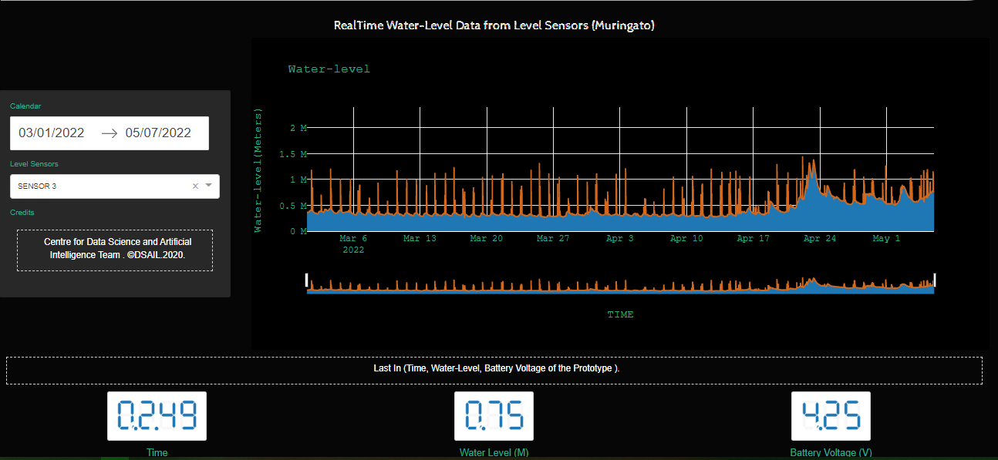
Data visualization app
Web application link
https://water-monitoring-258811.wl.r.appspot.com

Slide 11
UPNEXT
11
ANOMALY DETECTION
PREDICTION

Slide 12
THANK YOU
12
Web - Dekut-dsail.github.io
Web - kabi23.github.io
Github – DEKUT-DSAIL

